Slide 1
Biological Oxidations of Organic Compounds

Slide 2
1. Dehydrogenation by NAD⁺ or FAD (or FMN).
a) NAD⁺ + 2e⁻ + 2H⁺ → NADH + H⁺
O
H
O
+
:
+
H
+
H⁻
H
- NAD⁺/NADH is a soluble e- carrier
- able to diffuse to its target

Slide 3
b) FAD + 2e- + 2H⁺ → FADH₂
H
H
C
C
C
C
+ H• + H•
H
H
H
H
FAD/FADH₂ is usually TIGHTLY BOUND as a prosthetic group of an enzyme
All dehydrogenation reactions are catalyzed by DEHYDROGENASES

Slide 4
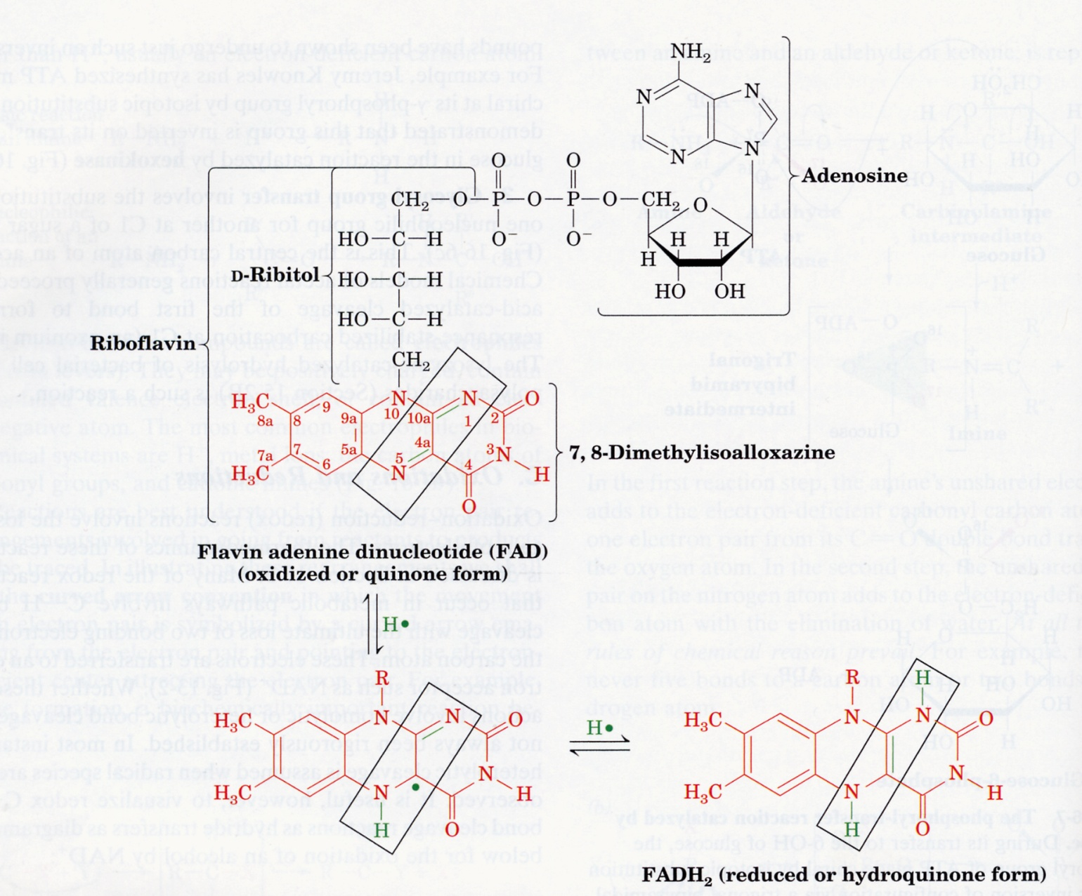
FAD/FADH₂
Voet & voet 3rd ed.

Slide 5
2. Combination with O
- Removal of e⁻’s by O which “pulls” e-’s away from the C or H nucleus. C or H becomes oxidized ; O becomes reduced.
- These reactions are catalyzed by oxidases
O
H
O
O
C
H
C
H
H
C
H
H
O
H
O
C
O
4
3

Slide 6
Oxidation states of carbon
C─H +2
C--C +1
C─O 0
C─S 0
C─N 0

Slide 7
2. Combination with O
- Removal of e⁻’s by O which “pulls” e-’s away from the C or H nucleus. C or H becomes oxidized ; O becomes reduced.
- These reactions are catalyzed by oxidases
O
H
O
O
C
H
C
H
H
C
H
H
O
H
O
C
O
4
3
8
6
4
2
0

Slide 8
Carbohydrates have fewer calories than fats because carbon is already partially oxidized….
Long Chain FA’s (9.3 kcal/g)
O=CCH₂ CH₂ CH₂ CH₂ CH₂ CH₂ ….
Carbohydrates (4 kcal/g)
O=CCHOHCHOHCHOHCHOHCH₂OH
O-
H

Slide 9
Individual C’s can have different oxidation states:
O
1
O
2
O
7
C
H
3
Pyruvate

Slide 10
Oxidative Metabolism
Production of chemical energy via oxidation of pyruvate

Slide 11
Oxidation of pyruvate occurs in mitochondria
Pyruvate
Porin
Pyruvate Translocase
Cytosol
Mitochondria
Pyruvate
CO₂
PDH multi-enzyme complex
∆G°= -8.0 kcal/mol
NADH + H⁺
Acetyl-CoA
TCA cycle

Slide 12
Glycolytic enzymes are cytosolic.
PDH and TCA cycle enzymes are mitochondrial.
Fate of cytosolic pyruvate is lactate or alanine.
Sole fate of mitochondrial pyruvate is the TCA cycle (Acetyl-CoA, Oxaloacetate).

Slide 13
Pyruvate Dehydrogenase
-role of vitamins

Slide 14
Pyruvate Dehydrogenase Complex
- links glycolysis & TCA cycle
H
S
C
o
A
O
NAD⁺
O
H
C
COO⁻
H
C
S
C
o
A
3
3
C
O
NADH
2
PDH

Slide 15
Role of Vitamins & Cofactors in PDH
Thiamine → Thiamine Pyrophosphate
Niacin → NAD⁺
Riboflavin → FAD (Flavin Adenine Dinucleotide)
Panthothenic Acid → Coenzyme A
Lipoic Acid → Lipoamide

Slide 16
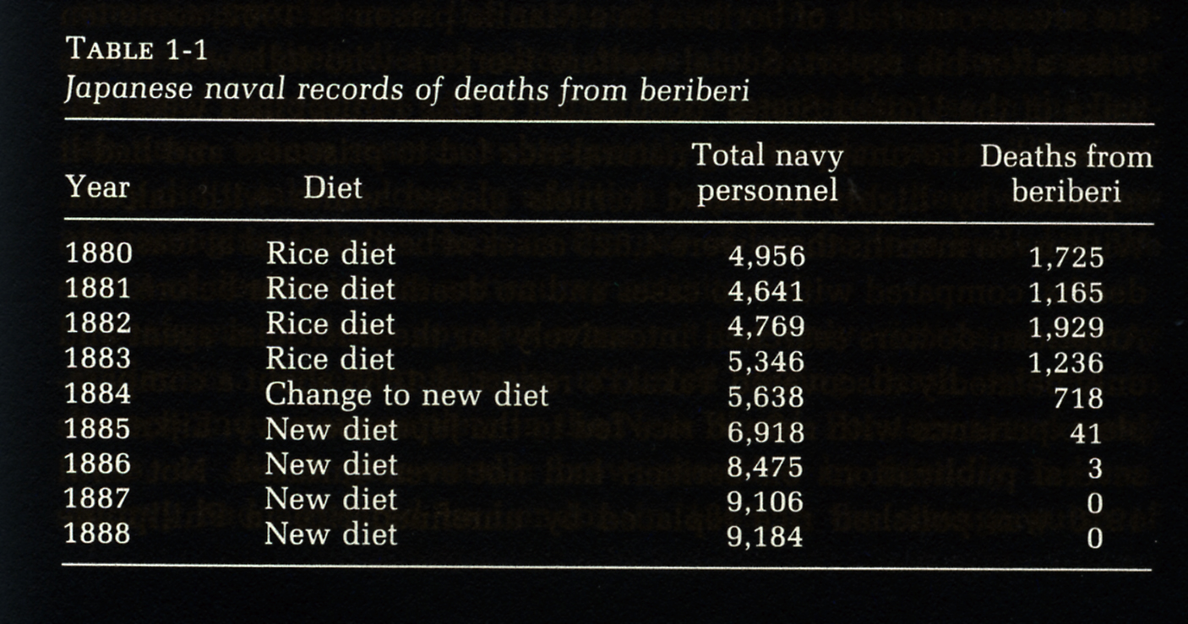
Discovery of thiamine (and vitamins)

Slide 17
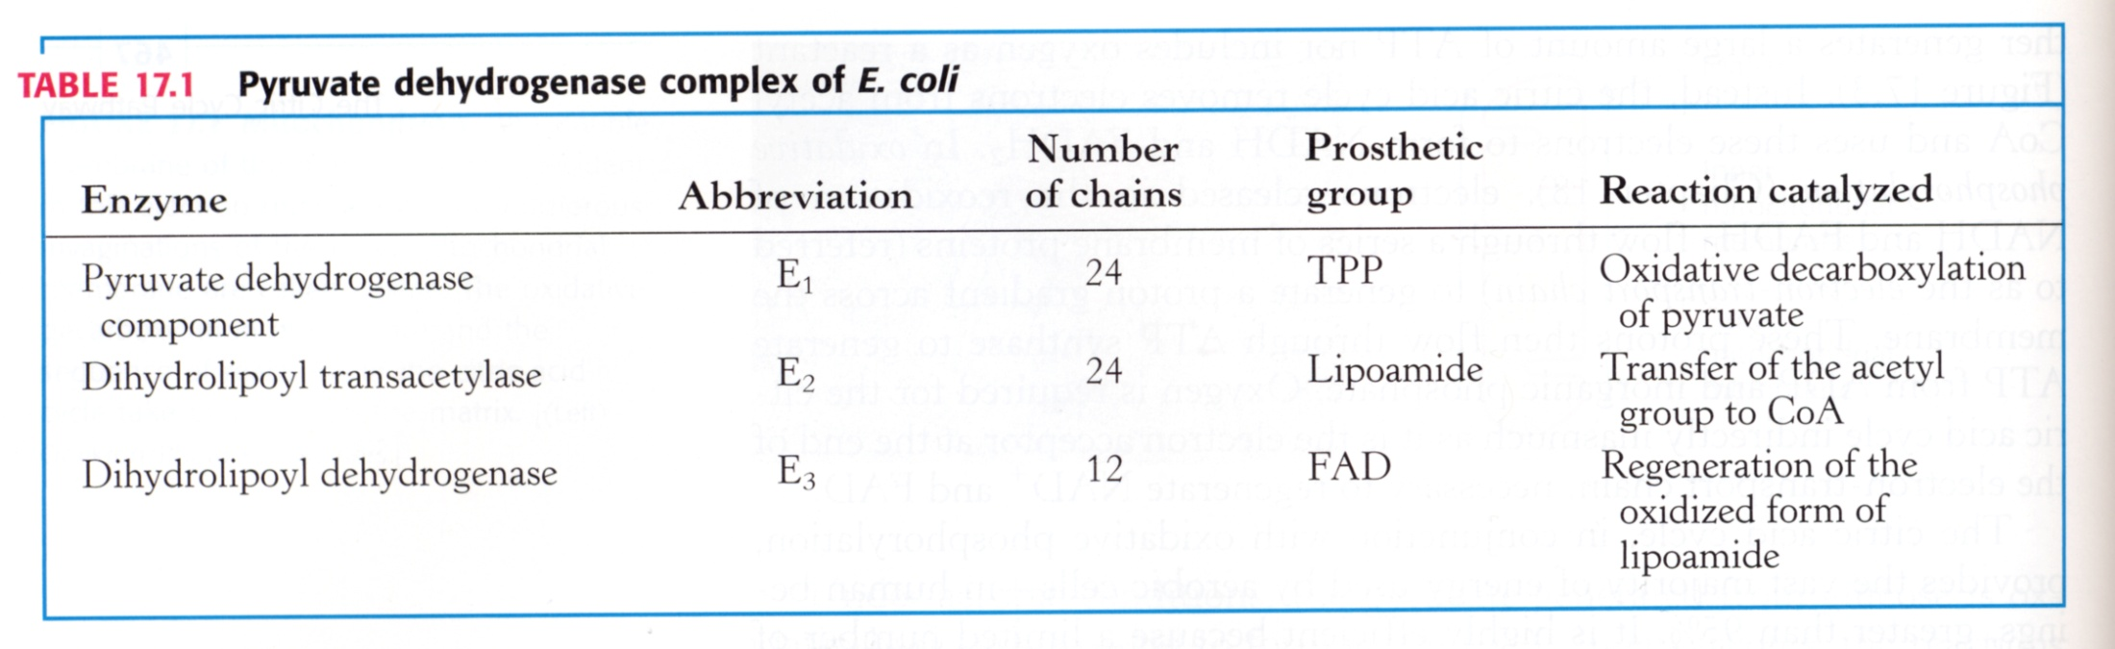

Slide 18
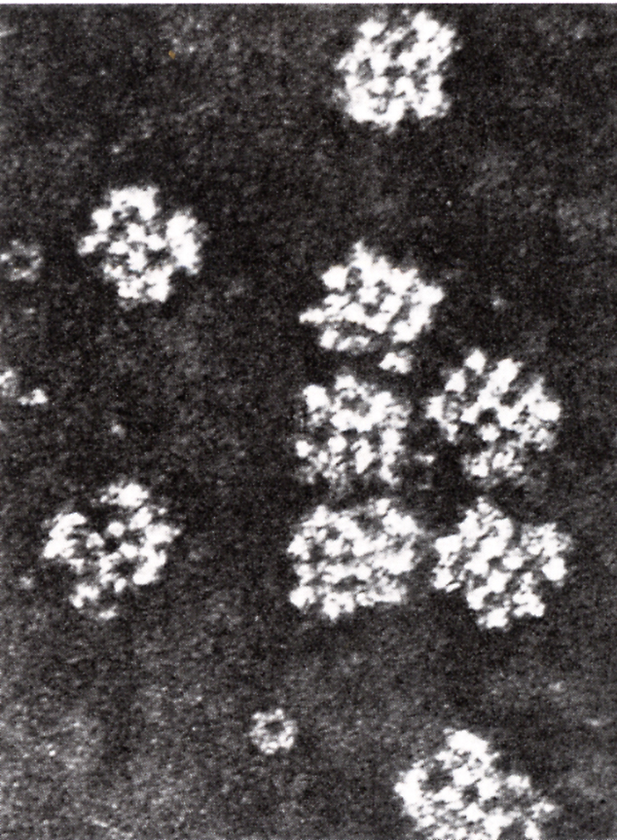
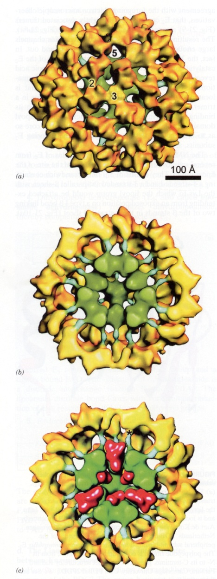
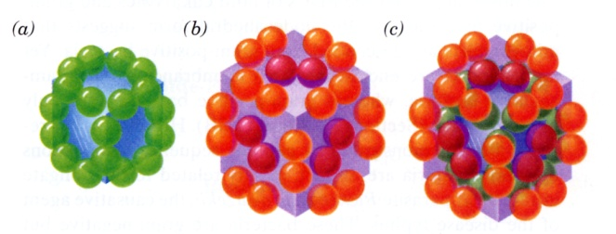
3D Imaging of PDH Complex
Voet & voet 3rd ed.

Slide 19
General Decarboxylation
O
O
β
C
CH₂
–
CO₂
C
CH₂
+
CO₂
O
O
α
CH₃
C
–
+
CO₂
CH₃
C
•
CO₂
•
pyruvate

Slide 20
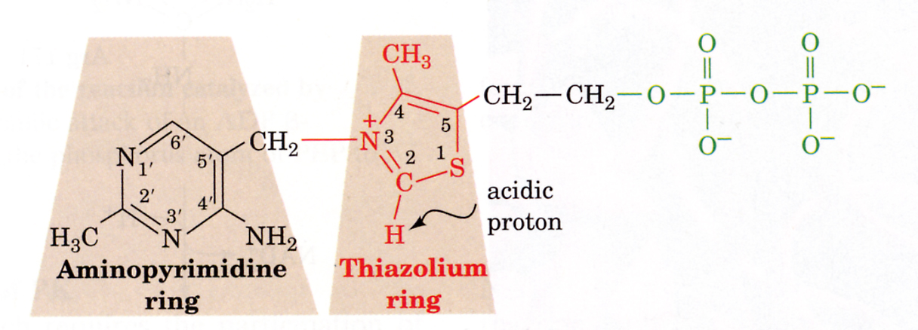
Thiamine Pyrophosphate
Voet & voet 3rd ed.

Slide 21
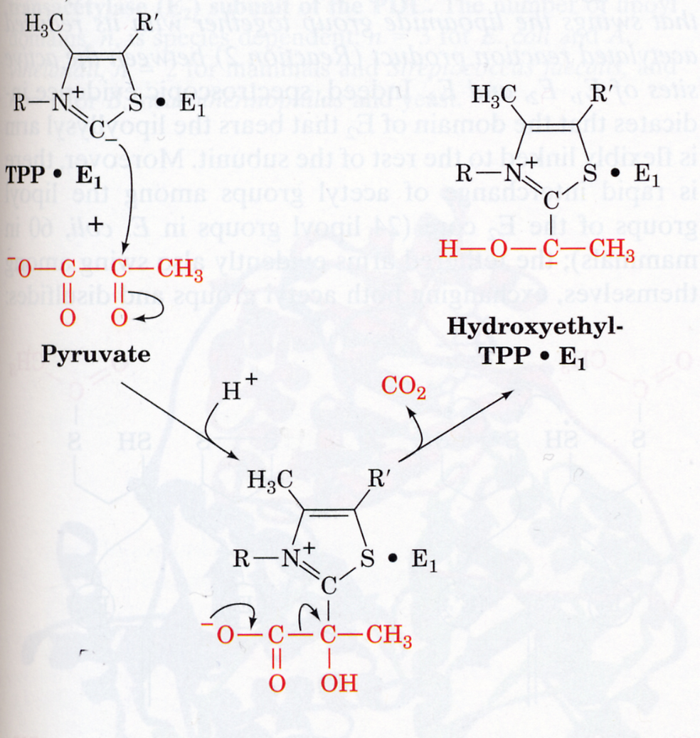
Mechanism of pyruvate decarboxylation and oxidation by PDH
Step 1:
TPP-dependent α-decarboxyl-ation
Voet & voet 3rd ed.

Slide 22
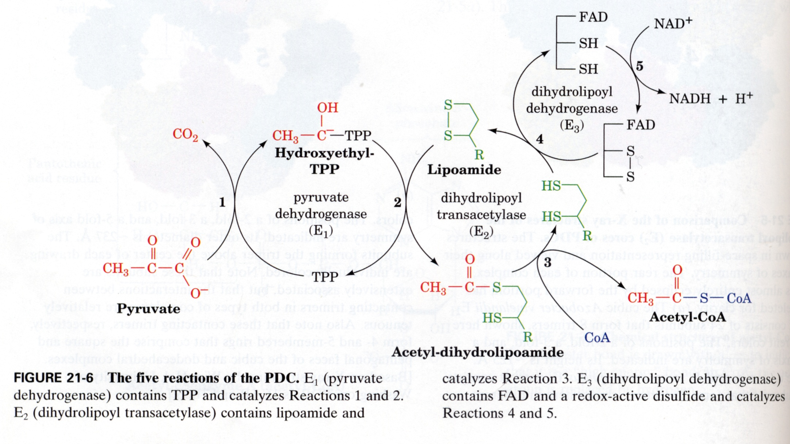
Complete PDH mechanism

Slide 23
Pyruvate Dehydrogenase
H
S
C
o
A
O
NAD⁺
O
H
C
COO⁻
H
C
S
C
o
A
3
3
10 e⁻
8 e⁻
C
O
NADH
2

